Slide 1

Birth Equity Framework for Maternal and Infant Health
Birth Equity Breakfast
Joia Crear-Perry MD, Founder/President

Slide 2
birth equity (noun):
1. The assurance of the conditions of optimal births for all people with a willingness to address racial and social inequalities in a sustained effort.
Joia Crear-Perry, MD
National Birth Equity Collaborative
Notes:
With the name birth equity in our name, we wanted to really define what that means. We deduced our definition from healht equity and reproductive justice definitions to make sure we capture what it means to advocate for all women and famileis to have the opportunity to have healthy birth with no barriers.
Read
We say sustained effort because these deep seated disparities in birth outcomes are not created quickly and will NOT be resolved quickly, it will be a sustained effort.

Slide 3

Mission
To reduce Black maternal and infant mortality through research, family centered collaboration and advocacy.
Goal
Reducing black infant mortality rates by 50% in the next 10 years.
Our vision is that every Black infant will celebrate a healthy first birthday with their families.

Slide 4
NBEC Focus
CLINICAL
SOCIAL
+
Dismantling systems of power and racism
Education on SDHI
“Working in this area of overlap is part of the reason why programs like Healthy
Start, Case Management, NFP, and Centering experience much of their success.”
– Arthur James, M.D.

Slide 5
Human Rights – The Global Standard
Article 2.
Everyone is entitled to al the rights and freedoms set forth in this Declaration, without distinction of any kind, such as race, color, sex, language, religion, political or other opinion, national or social origin, property, birth or other status.
Article 25.
(1) Everyone has the right to a standard of living adequate for the health and well-being of himself and of his family, including food, clothing, housing and medical care and necessary social services
(2) Motherhood and childhood are entitled to special care and assistance. All children, whether born in or out of wedlock, shall enjoy the same protection.
Article 3.
Everyone has the right to life, liberty and security of person

Slide 6

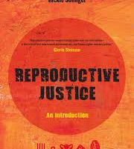
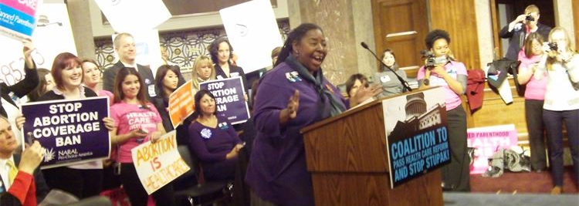
Reproductive Justice
The human right to maintain personal bodily autonomy, have children, not have children, and parent the children we have in safe and sustainable communities.
-Loretta Ross
We must…
Analyze power systems
Address intersecting oppressions
Center the most marginalized
Join together across issues and identities

Slide 7
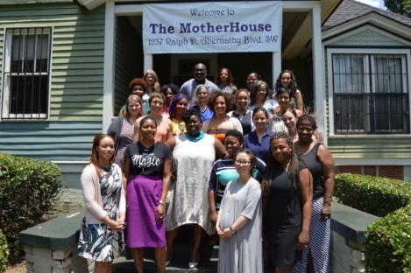
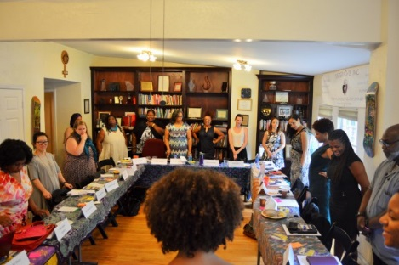
Black Mamas Matter
Black Mamas Matter is a Black women-led cross-sectoral alliance. We center Black mamas to advocate, drive research, build power, and shift culture for Black maternal health, rights, and justice.

Slide 8

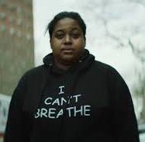
In the News
Notes:
https://www.americanprogress.org/issues/early-childhood/reports/2018/02/01/445576/exploring-african-americans-high-maternal-infant-death-rates/
Black mothers who are college-educated fare worse than women of all other races who never finished high school.
Obese women of all races do better than black women who are of normal weight.
Wealthy Black women do worse than white, Hispanic and Asian mothers in the poorest ones.

Slide 9
Root Causes
Institutional
Racism
Class Oppression
Gender
Discrimination
and Exploitation
LABOR
MARKETS
TAX
POLICY
Power and Wealth Imbalance
GLOBALIZATION
&
DEREGULATION
HOUSING
POLICY
EDUCATION
SYSTEMS
SOCIAL
SAFETY
NET
SOCIAL
NETWORKS
Safe
Affordable
Housing
Job
Security
Social Determinants of Health
Transportation
Living
Wage
Quality
Education
Availability
of Food
Social
Connection
& Safety
Psychosocial Stress / Unhealthy Behaviors
Disparity in the Distribution of Disease, Illness, and Wellbeing
Adapted by MPHI from R. Hofrichter, Tackling Health Inequities Through Public Health Practice.

Slide 10
Institutional
Personally Mediated
Internalized
LEVELS OF RACISM
Camara Jones, MD, PhD, Past President APHA
Notes:
3 Levels of Racism (Camara Jones, MD, MPH)
Institutionalized Racism
Historical perspectives regarding health and health care providers
Personally Mediated Racism
Stereotyping
The genetic excuse
Internalized Racism
Low expectations of health care systems
Acceptance that bad health is inevitable

Slide 11
Institutionalized racism- the structures, policies, practices and norms resulting in differential access to the goods, services and opportunities of societies by race.
Personally mediated - the differential assumptions about the abilities, motives and intentions of others by race.
Internalized racism - the acceptance and entitlement of negative messages by the stigmatized and non stigmatized groups.
Camara Jones, MD, PhD, Past President APHA

Slide 12
Race- A Social Construct Human Genome Project Completed in 2003
Black mothers who are college-educated fare worse than women of all other races who never finished high school.
Obese women of all races do better than black women who are of normal weight.
Black women in the wealthiest neighborhoods do worse than white, Hispanic and Asian mothers in the poorest ones.
African American women who initiated prenatal care in the first trimester still had higher rates of infant mortality than non-Hispanic white women with late or no prenatal care.
Race is not genetic.
It has historically been used as a taxonomic categorization based on common hereditary traits (such as skin color) to elucidate the relationship between or ancestry and our genes
HOW?
The experience of racism—not “race” itself—compromises health and wellbeing.
EXAMPLE
Black immigrant women—mostly from African and Caribbean countries—who arrived in the United States as adults enjoy better birth outcomes than native-born African American women.
Notes:
https://www.americanprogress.org/issues/early-childhood/reports/2018/02/01/445576/exploring-african-americans-high-maternal-infant-death-rates/
https://www.salon.com/2017/12/31/how-hospitals-are-failing-black-mothers_partner/
https://www.psychologytoday.com/blog/without-prejudice/201612/race-social-construction
https://www.sun.ac.za/english/faculty/healthsciences/cmel/Documents/taking%20race%20out%20of%20human%20genetics.pdf

Slide 13
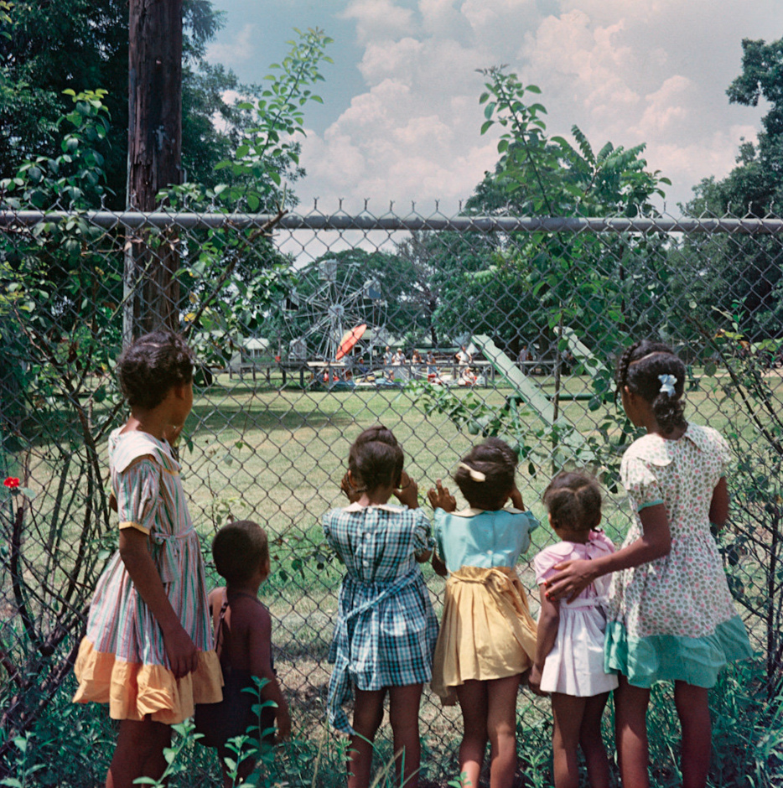
Racial Health Inequities:
Individual v Collective Accountability
“Racially discriminatory policies have usually sprung from economic, political, and cultural self-interests, self-interests that are constantly changing.”
Politicians seek political self-interest.
Capitalists seek increased
profit margins.
Cultural professionals seek professional advancement.
― Ibram X. Kendi, Stamped from the Beginning: The Definitive History of Racist Ideas in America
Notes:
“Racially discriminatory policies have usually sprung from economic, political, and cultural self-interests, self-interests that are constantly changing. Politicians seeking higher office have primarily created and defended discriminatory policies out of political self-interest—not racist ideas. Capitalists seeking to increase profit margins have primarily created and defended discriminatory policies out of economic self-interest—not racist ideas. Cultural professionals, including theologians, artists, scholars, and journalists, were seeking to advance their careers or cultures and have primarily created and defended discriminatory policies out of professional self-interest—not racist ideas.”
― Ibram X. Kendi, Stamped from the Beginning: The Definitive History of Racist Ideas in America

Slide 14

Social Determinants of
Infant and Maternal Mortality

Slide 15
Maternal Mortality
Maternal death due to complications of pregnancy and childbirth.
Clinical Risk Factors | Social Risk Factors
Eclampsia Cardiac disease Acute renal failure Preconception BMI Chronic conditions Serious obstetric complications Blood transfusion Ventilation Hysterectomy Heart failure | Housing Income Neighborhood safety Air quality and environmental stresses Food Insecurity Access to quality, comprehensive health care services Low educational attainment Unemployment and rigid scheduling
Notes:
http://www.cdc.gov/sids/aboutsuidandsids.htm

Slide 16
Preterm Related Conditions
Babies born at 20-37 weeks gestation are at risk for preterm related health conditions
Clinical Risk Factors | Social Risk Factors
Short cervix Previous preterm birth Short interval between pregnancies History of certain types of surgery on the uterus or cervix Pregnancy complications such as multiple pregnancy and vaginal bleeding Low pre-pregnancy weight Smoking during pregnancy Substance use during pregnancy | Racial residential segregation (isolation) Unemployment Median household income Structural racism (racial inequality in employment) Gender inequality in earnings.
Notes:
http://www.acog.org/Patients/FAQs/Preterm-Premature-Labor-and-Birth#risk

Slide 17
Congenital Malformations
Congenital malformations are birth defects or conditions present at birth. They can cause problems in overall health, how the body develops or how the body works. Most common congenital malformations underlying cause of death include congenital malformation of the heart and chromosomal abnormalities.
Clinical Risk Factors | Social Risk Factors
Genetic or inherited causes including chromosomal defects, single gene defects, dominant or recessive inheritance Environmental causes including a drug, alcohol, or maternal disease Multifactorial birth defects caused by a combination of genes and environmental exposures. | Uninsured rates Prevalence of sexually transmitted infections within the population Food insecurity Limited access to healthy foods
Notes:
http://www.marchofdimes.org/complications/birth-defects-and-health-conditions.aspx
http://www.childrenshospital.org/conditions-and-treatments/conditions/birth-defects-and-congenital-anomalies/symptoms-and-causes

Slide 18
SIDS/SUIDS
The sudden death of an infant less than 1 year of age that cannot be explained after a thorough investigation is conducted, including a complete autopsy, examination of the death scene, and a review of the clinical history. SUID category combines ICD–10 codes for SIDS, other ill-defined and unspecified causes of mortality, and accidental suffocation and strangulation in bed.
Clinical Risk Factors | Social Risk Factors
Inadequate prenatal care Intrauterine growth restriction Short inter-pregnancy interval Substance use Viral respiratory infection Genetic factors Sleep environment | Criminalization of Drug Addiction Lax Environmental Regulations Poor Housing Quality
Notes:
http://www.cdc.gov/sids/aboutsuidandsids.htm

Slide 19
Addressing Root Causes
Social Structure
Despite available research, opinion leaders, local change agents, and policy makers give little attention to inequities and their root causes. Typically focus on remedial options…
Power and Wealth Imbalance
Social Determinants of Health
Psychosocial Stress /
Unhealthy Behaviors
Inequity in the Distribution of
Disease, Illness, and Wellbeing

Slide 20
Racial Equity Lens
Focusing resources into only safe sleep or education campaigns does not efficiently address maternal health inequities or the preventable causes of preterm birth.
Values communities with highest risk of poor outcomes
Efficient use of program funds
Encourages community partnerships and innovation
Makes racial equity an priority for providers
Centers and integrates social determinants into health systems improvement

Slide 21
Best Practices
Prioritize community voice and research on stress responses to
Include equity and trauma informed care QI indicators into systematic models
Staff-wide training on racial equity
Community training on birth justice and advocacy
Partner and collaborate with non-health sectors.
Improve state perinatal quality collaborative with comprehensive data, disaggregated by race, geography and SES.
Standardize data collection with ACOG ICD-10 codes.
Employ aspects of the AIM Patient Safety Bundles.
Accept Medicaid- without exception- in all area hospitals.
Conduct research on predisease pathways and connections between maternal and infant health.

Slide 22
Segregationists
Assimilationists
Anti-Racists
Notes:
“Slavery was as customary as prisons are today. Few could imagine an ordered world without them.”
― Ibram X. Kendi, Stamped from the Beginning: The Definitive History of Racist Ideas in America
“Of course, racist planters could not admit that Black runaways were self-reliant enough to effect their own safety and happiness—to be free.”
― Ibram X. Kendi, Stamped from the Beginning: The Definitive History of Racist Ideas in America
“When you truly believe that the racial groups are equal, then you also believe that racial disparities must be the result of racial discrimination. Committed to this antiracist idea of group equality, I was able to self-critique, discover, and shed the racist ideas I had consumed over my lifetime when I uncovered and exposed the racist ideas that others have produced over the lifetime of America.
“Racially discriminatory policies have usually sprung from economic, political, and cultural self-interests, self-interests that are constantly changing. Politicians seeking higher office have primarily created and defended discriminatory policies out of political self-interest—not racist ideas. Capitalists seeking to increase profit margins have primarily created and defended discriminatory policies out of economic self-interest—not racist ideas. Cultural professionals, including theologians, artists, scholars, and journalists, were seeking to advance their careers or cultures and have primarily created and defended discriminatory policies out of professional self-interest—not racist ideas.”
― Ibram X. Kendi, Stamped from the Beginning: The Definitive History of Racist Ideas in America
“That is what it truly means to think as an antiracist: to think there is nothing wrong with Black people, to think that racial groups are equal. There are lazy and unwise and harmful individuals of African ancestry. There are lazy and unwise and harmful individuals of European ancestry. There are industrious and wise and harmless individuals of European ancestry. There are industrious and wise and harmless individuals of African ancestry. But no racial group has ever had a monopoly on any type of human trait or gene—not now, not ever.”
― Ibram X. Kendi, Stamped from the Beginning: The Definitive History of Racist Ideas in America

Slide 23
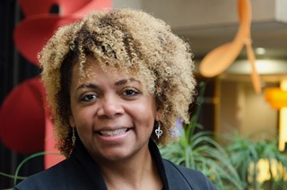

Thank you
Visit us at birthequity.org
Joia Crear-Perry, MD
Founder President
drjoia@birthequity.org

